Slide 1

BANK LOAN CASE STUDY
By Aditya sadakal

Slide 2
PROJECT DESCRIPTION
In this project, we will perform Exploratory Data Analysis (EDA) on two datasets: 'application_data' and 'previous_data'. These datasets contain information about loans provided by a bank or financial service provider.
The goal of our analysis is to identify patterns in the data and gain insights that can help us make informed decisions on whether to approve loan requests from applicants.
Through this analysis, we aim to provide valuable information and recommendations to support the loan approval process and improve decision-making for loan requests.

Slide 3
APPROACH
Exploring a large dataset for the first time was an exciting and immersive experience. The vast amount of data presented a unique challenge, but it also opened up numerous possibilities for exploration and analysis.
Before delving into the dataset, I took the time to familiarize myself with the loan system and identified the mandatory and essential fields in the official loan systems.
The dataset contains a wide range of information that requires thorough analysis. Large datasets often reveal valuable insights and trends in a particular field. Proper analysis of such data can greatly support data-driven decision-making.
Overall, working with a large dataset offers both challenges and opportunities. With careful examination and analysis, this dataset has the potential to provide valuable insights for informed decision-making.

Slide 4
TECH-STACK
The software used to analyze the datasets and perform the analysis on the same is – Jupyter Notebook.

Slide 5
INSIGHTS
Beginning with the analysis we will start with the ‘application_data’ dataset.
The dataset consists of 3,07,511 entries and 122 columns.
To find the missing values in percentage I used,
(df.isnull().mean() * 100).sort_values()
Around 47 columns had more than 50% missing values. To handle these missing values I dropped down the columns having more than 50% missing values, using
df.drop(['COMMONAREA_MEDI','COMMONAREA_AVG','NONLIVINGAPARTMENTS_MODE','NONLIVINGAPARTMENTS_MEDI','NONLIVINGAPARTMENTS_AVG','FONDKAPREMONT_MODE','LIVINGAPARTMENTS_MEDI','LIVINGAPARTMENTS_MODE','LIVINGAPARTMENTS_MEDI','NONLIVINGAPARTMENTS_AVG','FLOORSMIN_MEDI','FLOORSMIN_MODE','FLOORSMIN_AVG','YEARS_BUILD_MEDI','YEARS_BUILD_AVG','YEARS_BUILD_MODE','OWN_CAR_AGE','LANDAREA_MODE','LANDAREA_AVG','LANDAREA_MEDI','BASEMENTAREA_MEDI','BASEMENTAREA_AVG','BASEMENTAREA_MODE','EXT_SOURCE_1','NONLIVINGAREA_MEDI','NONLIVINGAREA_AVG','NONLIVINGAREA_MODE','ELEVATORS_MODE','ELEVATORS_AVG','ELEVATORS_MEDI','WALLSMATERIAL_MODE','APARTMENTS_MODE','APARTMENTS_AVG','APARTMENTS_MEDI','ENTRANCES_MEDI','ENTRANCES_AVG','ENTRANCES_MODE','LIVINGAREA_MEDI','LIVINGAREA_AVG','LIVINGAREA_MODE','HOUSETYPE_MODE','FLOORSMAX_MODE','FLOORSMAX_MEDI','FLOORSMAX_AVG','YEARS_BEGINEXPLUATATION_AVG','YEARS_BEGINEXPLUATATION_MEDI','YEARS_BEGINEXPLUATATION_MODE','TOTALAREA_MODE','EMERGENCYSTATE_MODE'],axis=1,inplace=True)
After dropping off those columns number of columns remaining was 75.

Slide 6
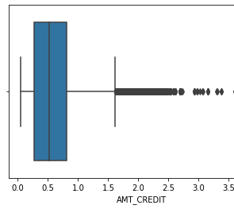
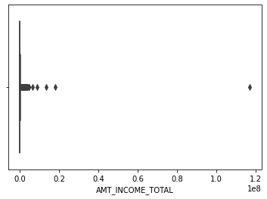
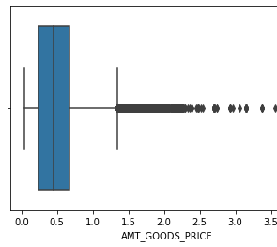
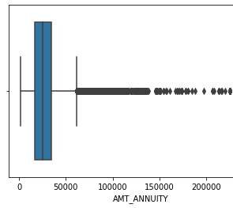
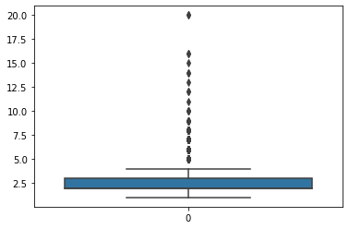
Outliers
AMT_GOODS_PRICE
To find out outliers we can use the boxplot.
sns.boxplot(x=df[COL_NAME’])
Following columns consists of outliers:
AMT_CREDIT
AMT_INCOME_TOTAL
AMT_GOODS_PRICE
AMT_ANNUITY
CNT_FAM_MEMBERS
CNT_FAM_MEMBERS

Slide 7
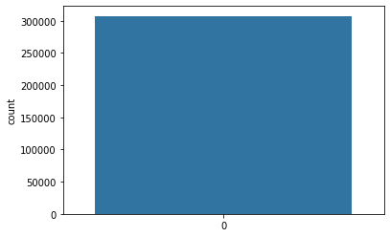
DATA IMBALANCE
To find data imbalance we can plot a histplot and find out the distribution of points over a column.
sns. histplot(df[COL_NAME’])
TARGET
FLAG_DOCUMENT_2

Slide 8
ANALYSIS
Univariate Analysis:
We can plot a histplot to analyse a single-column distribution;
sns.histplot(data=df, x=‘COL_NAME’)
CODE_GENDER
NAME_CONTRACT_TYPE

Slide 9
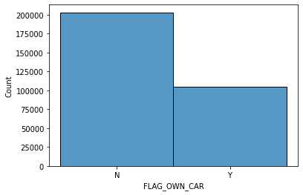
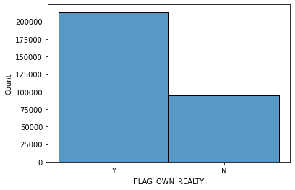

Slide 10
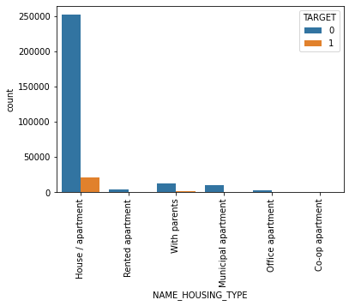
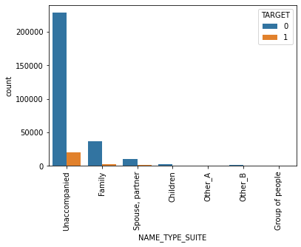
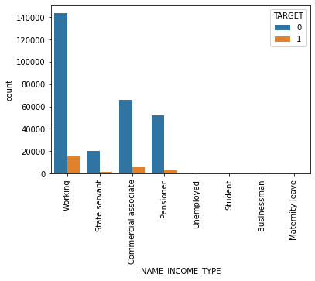
BIVARIATE ANALYSIS:
We can do the bivariate analysis using a countplot;
sns.countplot(data=df,x='NAME_HOUSING_TYPE', hue='TARGET')
plt.xticks(rotation=180)=90)

Slide 11
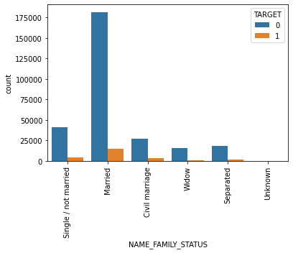
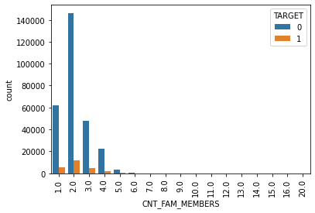
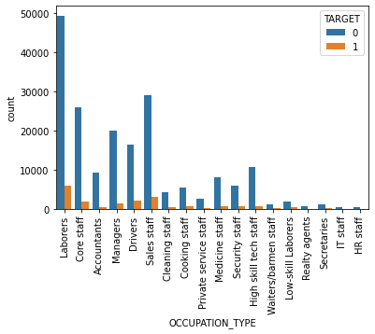
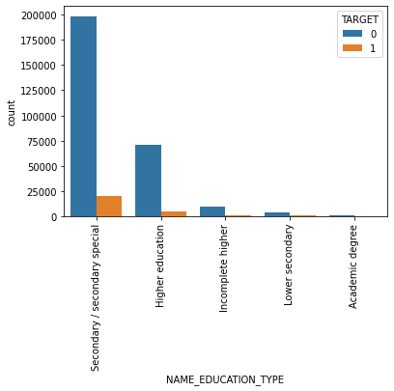

Slide 12
CORRELATION
We can find correlations among columns using correlation matrix;
corr_matrix = df.corr()
correlations = corr_matrix[‘COL_NAME']
sorted_corr = correlations.abs().sort_values(ascending=False)
Top correlations are:
OBS_60_CNT_SOCIAL_CIRCLE AND OBS_30_CNT_SOCIAL_CIRCLE 0.998490
AMT_GOODS_PRICE AND AMT_CREDIT 0.986968
FLAG_EMP_PHONE AND DAYS_EMPLOYED 0.999755
DEF_60_CNT_SOCIAL_CIRCLE AND DEF_30_CNT_SOCIAL_CIRCLE 0.860517
CNT_CHILDREN AND CNT_FAM_MEMBERS 0.879161
AMT_GOODS_PRICE AND AMT_ANNUITY 0.775109
AMT_CREDIT AND AMT_ANNUITY 0.770138

Slide 13
INSIGHTS
Beginning with the analysis of the ‘previous_data’ dataset.
The dataset consists of 16,70,214 entries and 37 columns.
To find the missing values in percentage I used,
(df.isnull().mean() * 100).sort_values()
Two columns were dropped namely
RATE_INTEREST_PRIVILEGED
RATE_INTEREST_PRIMARY
After dropping those columns number of columns remaining was 35.

Slide 14
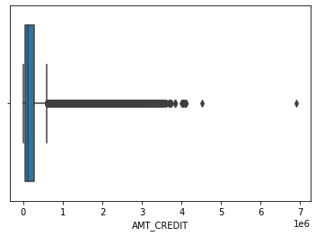
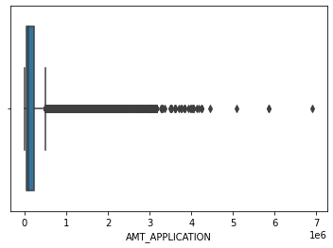
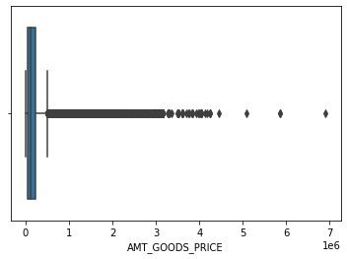
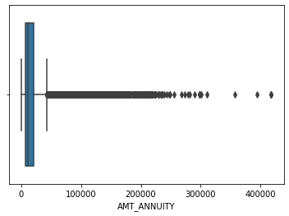
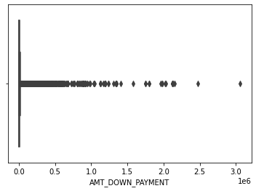
OUTLIERS
To find out outliers we can use the boxplot.
sns.boxplot(x=df[COL_NAME’])
Following columns consists of outliers:
AMT_CREDIT
AMT_ANNUITY
AMT_APPLICATION
AMT_DOWN_PAYMENT
AMT_GOODS_PRICE
CNT_PAYMENT

Slide 15
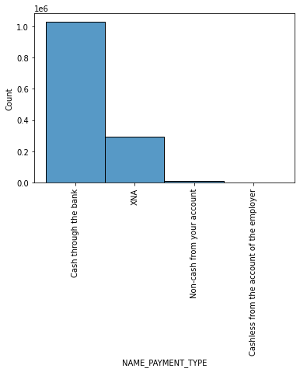
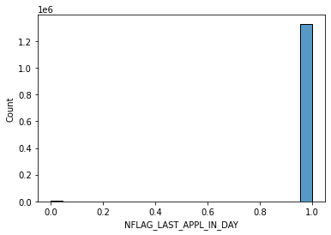
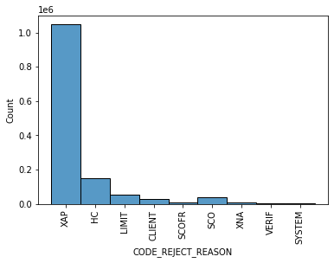
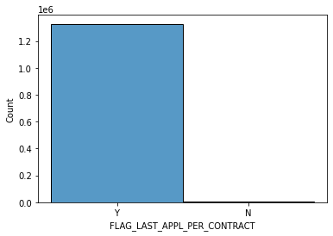
DATA IMBALANCE
To find data imbalance we can plot a histplot and find out the distribution of points over a column.
sns. histplot(df[COL_NAME’])
Following columns consist of imbalance:
FLAG_LAST_APPL_PER_CONTRACT
NAME_CONTRACT_TYPE
NAME_PAYMENT_TYPE
CODE_REJECT_REASON
NFLAG_LAST_APPL_IN_DAY

Slide 16
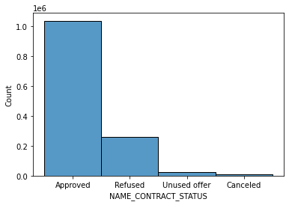
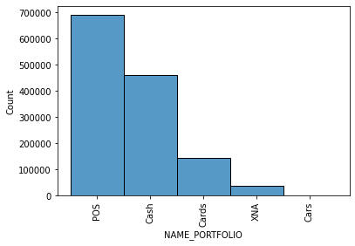
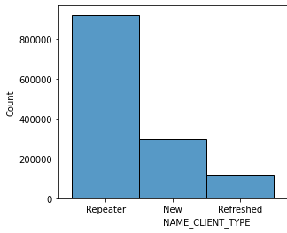
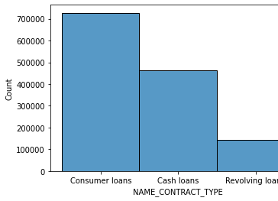
ANALYSIS

Slide 17
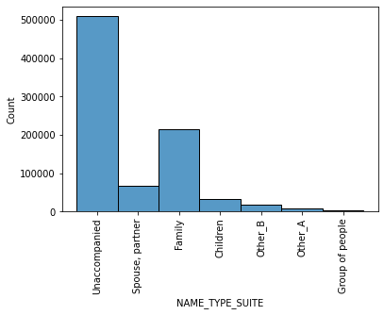
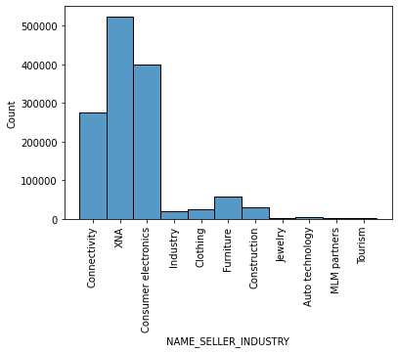
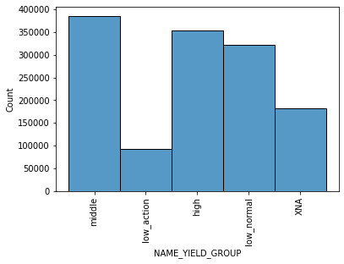

Slide 18
CORRELATION
For finding out the correlations among the columns I used;
corr_matrix = df.corr()
correlations = corr_matrix[‘COL_NAME']
sorted_corr = correlations.abs().sort_values(ascending=False)
Top correlations are:
AMT_GOODS_PRICE AND AMT_CREDIT 0.993086
AMT_APPLICATION AND AMT_CREDIT 0.973411
AMT_ANNUITY AND AMT_CREDIT 0.816429
AMT_APPLICATION AND AMT_GOODS_PRICE 0.999884
DAYS_LAST_DUE AND DAYS_TERMINATION 0.927990
DAYS_FIRST_DRAWING AND DAYS_LAST_DUE_1ST_VERSION 0.803494

Slide 19
SUMMARY
The given dataset has outliers and missing values which can lead to incorrect results.
Most of the contracts were of type ‘Consumer loans’ followed by ‘Cash loans’ and ‘Revolving loans’.
Most favourable payment type was cash through the bank.
Common rejection reason for a bank to a person falls in ‘XAP’.
Most of the applicants weren’t accompanied by anyone. If there was someone then it was from the family(mostly).
Most of the applicants were repeaters.
Most of the applicant’s portfolio had ‘POS’ and ‘Cash’.

Slide 20
THANK YOU
tanvisadakal@gmail.com

